Slide 1
Capstone Project: Battle of the Neighborhoods
Housing Market in Paris

Slide 2
Introduction
Paris is one of the most expensive cities in the world when it comes to real estate.
Finding an apartment in Paris is a true mission, and can take up to months of searching, appointments, visits, only to see the apartment go to someone else for most cases.
However, with interest rates as low as 1% for a credit line over 25 years, and with real estate picking up value year after year at high percentages, becoming a homeowner has become appealing to most Parisians, as soon as they become active in the work market.

Slide 3
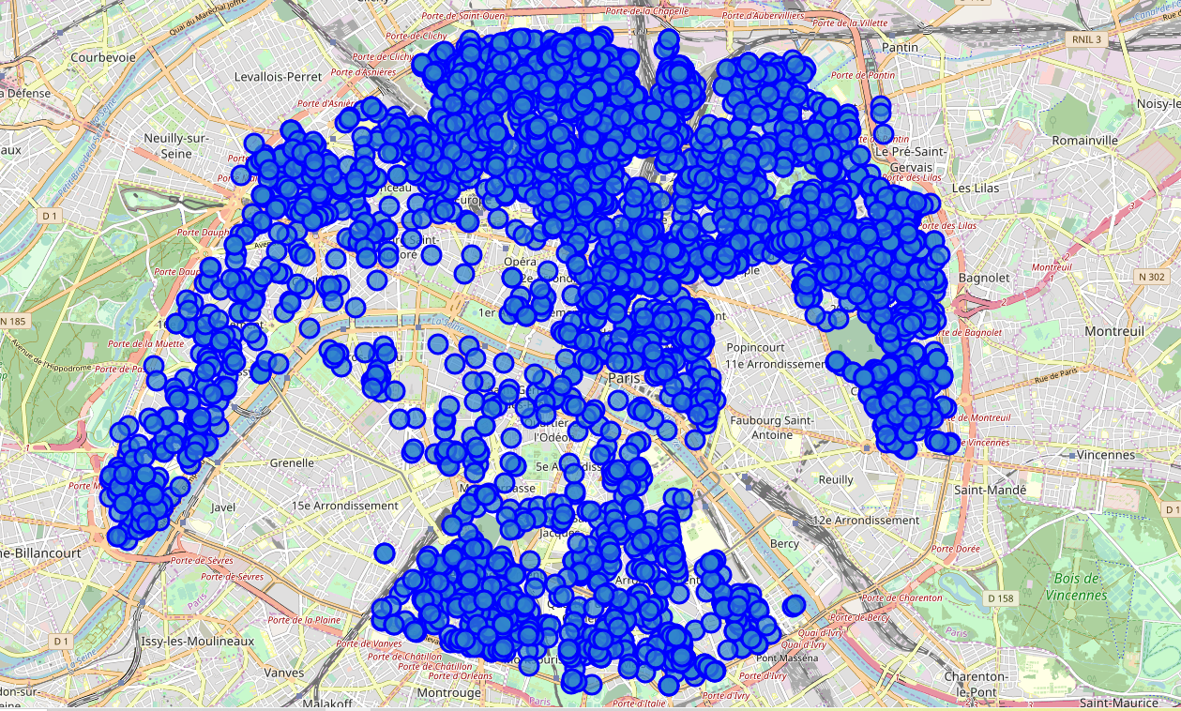
Methodology
Visual of he addresses of our dataset in a Paris map

Slide 4
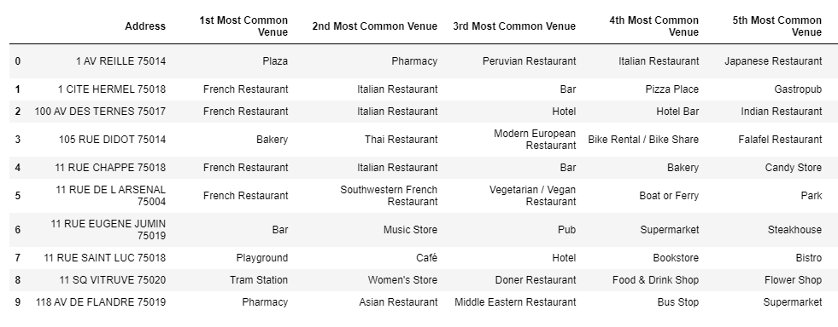
Methodology
Dataframe of our most common venues

Slide 5
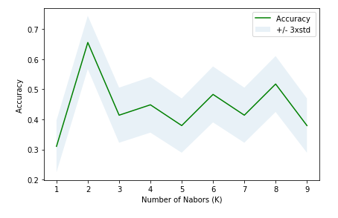
Methodology
Clustering using the k-mean nearest neighbhod method

Slide 6
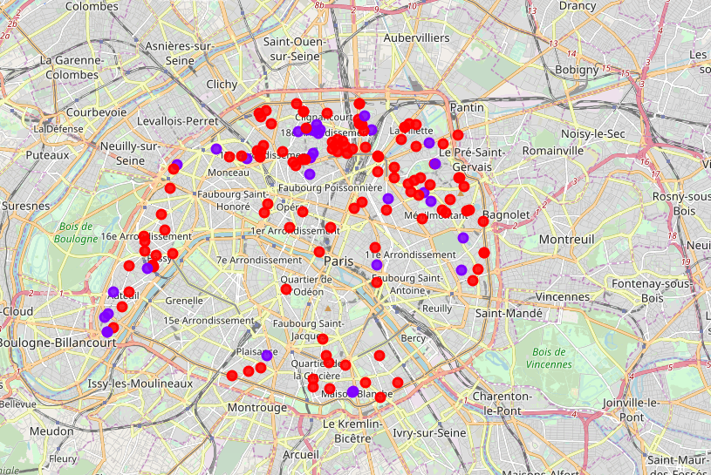
Methodology
Map of our clusters

Slide 7
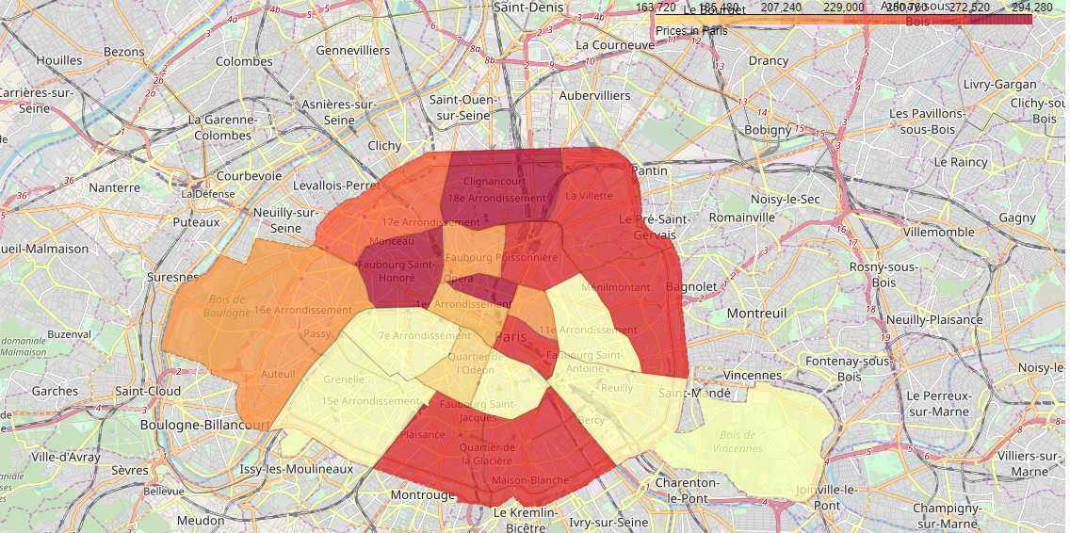
Methodology
Heat map of apartment prices in Paris

Slide 8
Results
We notice that the cluster 1 is mostly situated in the northern part of Paris, and more precisely in the 18th, the 19th and 20th districts, but also very present in the 13th and the 16th districts.
When we look at our most common venues in this cluster, we can clearly see that restaurants are the most dominant venue present in them, which makes the cluster 1 a good fit for people looking for animated streets and an active social life.
This cluster 0 seems to be more spread than cluster 1, with many restaurants nearby as well.
But overall, the 2 clusters seem very similar, which leads us to assume that Paris is a homogenous city.

